Slide 1
Personalized Tag Recommendation
Yuding Liang
March 2,2016

Slide 2
Outline
Introduction
Tensor Factorization
Reference

Slide 3
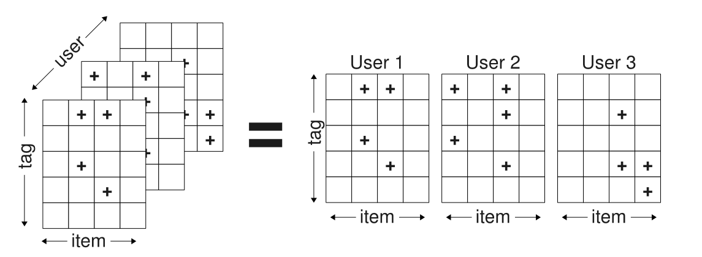
Introduction
Figure 1: The observed data in a tagging system forms a ternary relation S between users U, items I and tags T.

Slide 4
Tensor Factorization
Higher-Order-Singular-Value-Decomposition(HOSVD)
Ranking Tensor Factorization (RTF)
RTF vs. HOSVD

Slide 5
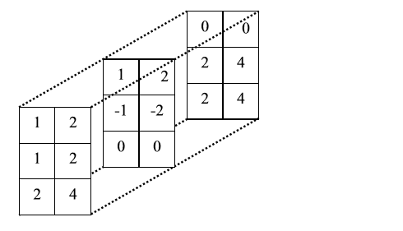


Tensor
0-order tensor = scalar
1-order tensor = vector
2-order tensor = matrix
3-order tensor:
……
N-order tensor $A$ is denoted as
$$A ε R^{I_{1}×…×I_{N}}$$

Slide 6




Unfolding of 3-order tensor
To apply HOSVD on a 3-order tensor $A$, three matrix unfolding operations are defined as follows:
$$A_{1} ε R^{I_{1}×I_{2}I_{3}}$$
$$A_{2} ε R^{I_{2}×I_{3}I_{1}}$$
$$A_{3} ε R^{I_{3}×I_{1}I_{2}}$$

Slide 7
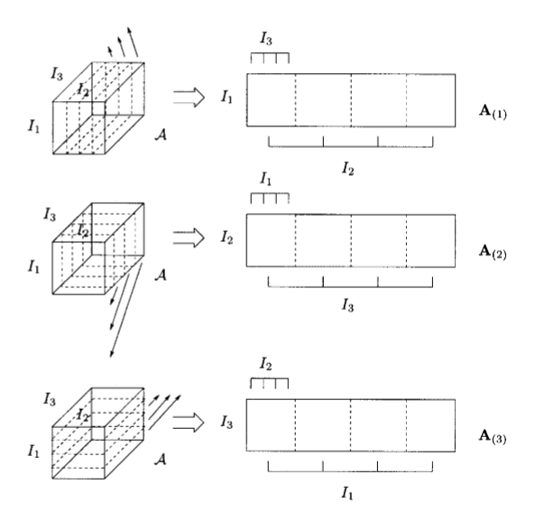

Slide 8
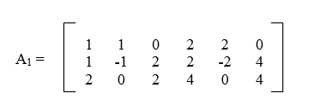
Quiz
What is the 1-mode matrix unfolding of left tensor ?

Slide 9

n-mode production
$A×_{n}U$ : n-mode production of an N-order tensor $A ε R^{I_{1}×…×I_{N}}$ by a matrix $U ε{ R}^{J_{n}×I_{n}}$
$A×_{n}U$is an $\left(I_{1}×I_{2}×…×I_{n−1}×J_{n}×I_{n+1}×…×I_{N}\right)$–tensor.

Slide 10
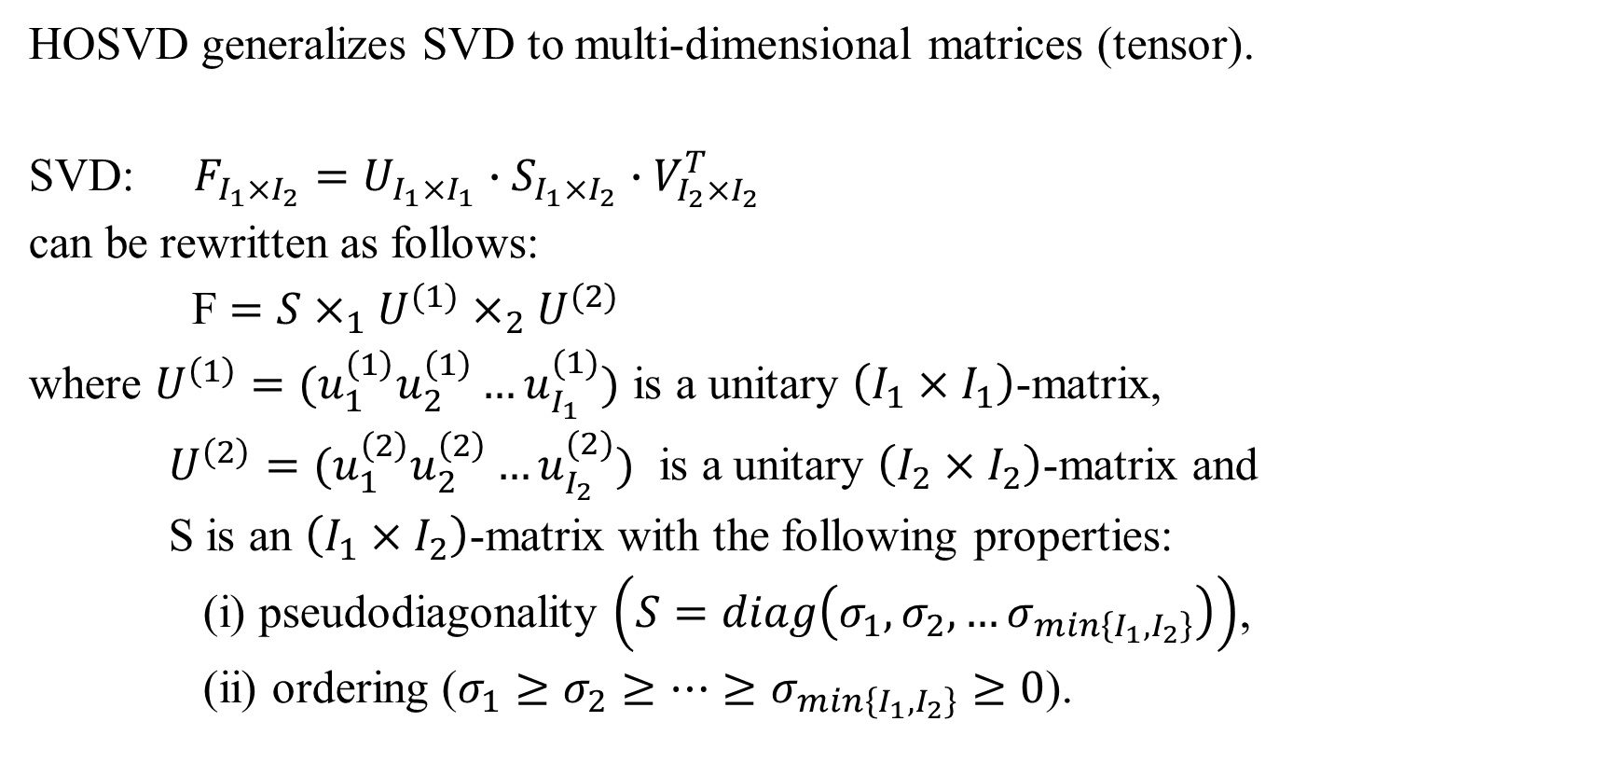
HOSVD
HOSVD generalizes SVD to multi-dimensional matrices (tensor).
SVD: $F_{I_{1}×I_{2}}=U_{I_{1}×I_{1}}∙S_{I_{1}×I_{2}}∙V_{I_{2}×I_{2}}^{T}$
can be rewritten as follows:
F $=S×_{1}U^{(1)}×_{2}U^{(2)}$
where $U^{\left(1\right)}=(u_{1}^{\left(1\right)}u_{2}^{\left(1\right)}…u_{I_{1}}^{(1)})$ is a unitary $\left(I_{1}×I_{1}\right)$-matrix,
$U^{\left(2\right)}=(u_{1}^{\left(2\right)}u_{2}^{\left(2\right)}…u_{I_{2}}^{(2)})$ is a unitary $\left(I_{2}×I_{2}\right)$-matrix and
S is an $\left(I_{1}×I_{2}\right)$-matrix with the following properties:
(i) pseudodiagonality $\left(S=diag\left(σ_{1},σ_{2},…σ_{min\left\{I_{1},I_{2}\right\}}\right)\right)$,
(ii) ordering ($σ_{1}≥σ_{2}≥…≥σ_{min\left\{I_{1},I_{2}\right\}}≥0$).

Slide 11
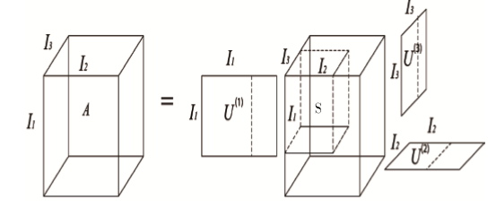

HOSVD:
$A=S×_{1}U^{(1)}×_{2}U^{\left(2\right)}×_{3}U^{(3)}$
Figure: Visualization of HOSVD

Slide 12
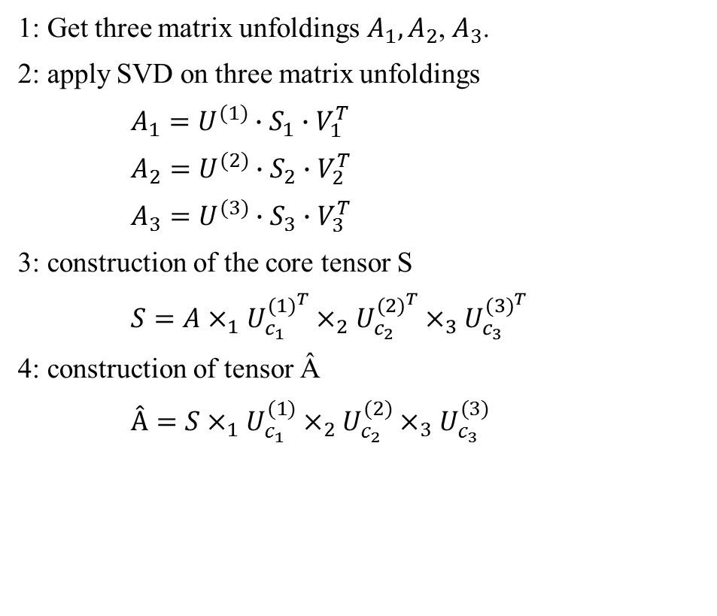
Steps of HOSVD
1: Get three matrix unfoldings $A_{1},A_{2}$, $A_{3}$.
2: apply SVD on three matrix unfoldings
$A_{1}=U^{(1)}∙S_{1}∙V_{1}^{T}$
$A_{2}=U^{(2)}∙S_{2}∙V_{2}^{T}$
$A_{3}=U^{(3)}∙S_{3}∙V_{3}^{T}$
3: construction of the core tensor S
$S=A×_{1}U_{c_{1}}^{{(1)}^{T}}×_{2}U_{c_{2}}^{{(2)}^{T}}×_{3}U_{c_{3}}^{{(3)}^{T}}$
4: construction of tensor Â
$Â=S×_{1}U_{c_{1}}^{(1)}×_{2}U_{c_{2}}^{(2)}×_{3}U_{c_{3}}^{(3)}$
The numbers c1, c2 and c3 of singular vectors are chosen by preserving a percentage of information of the original S1, S2, S3 matrices after appropriate tuning (the default percentage is set to 50% of the original matrix).

Slide 13
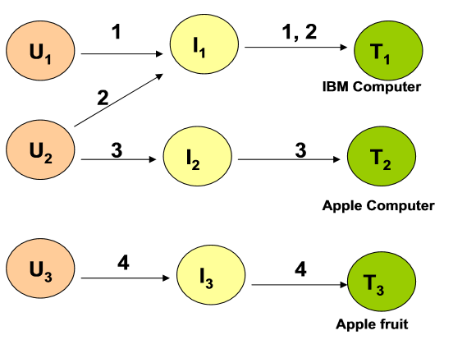
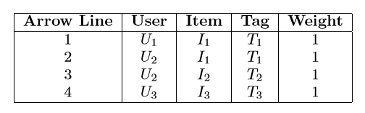
Running Example
Table: Tensor Constructed from the usage Data of the running example
Figure: Usage data of the running example

Slide 14
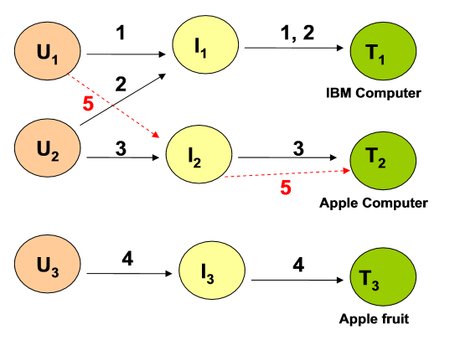
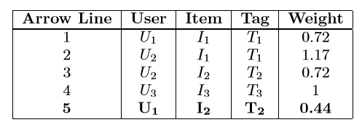
Table: Tensor Constructed from the algorithm output of the running example
Figure: Illustration of the algorithm output for the running example

Slide 15
Ranking Tensor Factorization (RTF)
Interpretation of the Data
Optimization Criterion

Slide 16
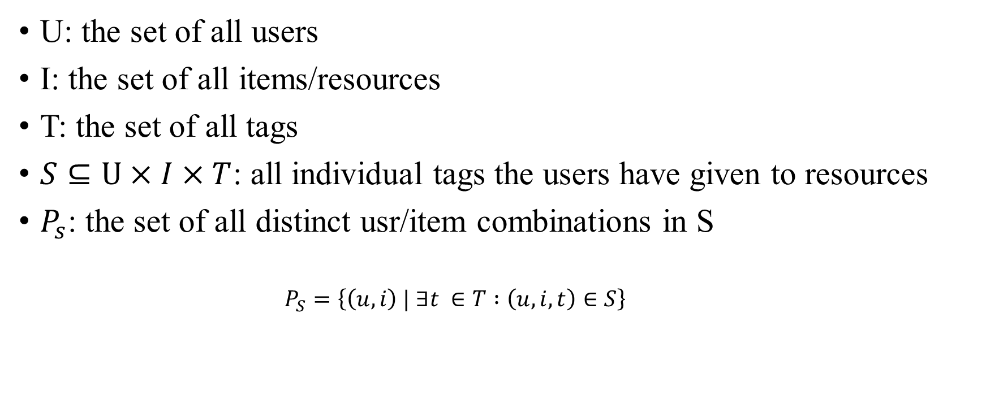
Notation
U: the set of all users
I: the set of all items/resources
T: the set of all tags
$S⊆U×I×T$: all individual tags the users have given to resources
$P_{s}$: the set of all distinct usr/item combinations in S
$$P_{S}=\left\{\left(u,i\right) | ∃t ∈T :\left(u,i,t\right)∈S\right\}$$

Slide 17
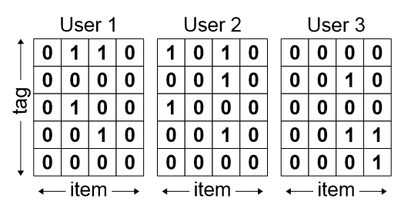

Interpretation of the Data
0/1 Interpretation scheme
$$y_{u,i,t}^{0/1}=\left\{\begin{matrix}1, \left(u,i,t\right) ε S \\ 0, else\end{matrix}\right.$$

Slide 18
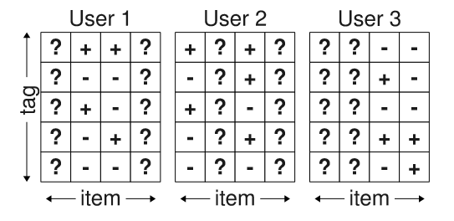

Interpretation of the Data
Post-based Ranking Interpretation Scheme
$$T_{u,i}^{+}≔\left\{t | \left(u,i\right) ε P_{S} Λ \left(u,i,t\right) ε S\right\}$$
$$T_{u,i}^{−}≔\left\{t | \left(u,i\right) ε P_{S} Λ \left(u,i,t\right)∉S\right\}$$
The values of Y pairwise ranking constraints
$$y_{u,i,t_{1}}^{p}>y_{u,i,t_{2}}^{p}=\left(u,i,t_{1}\right)∈T_{u,i}^{+} Λ \left(u,i,t_{2}\right)∈T_{u,i}^{−}$$

Slide 19

Optimization Criterion
Minimize an elementwise loss

Slide 20
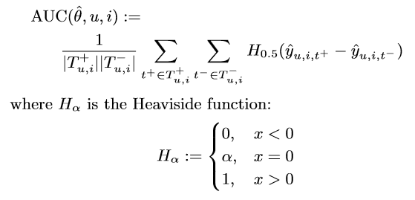

Optimization Criterion
Maximizes the ranking statistic AUC(area under the ROC-curve)

Slide 21
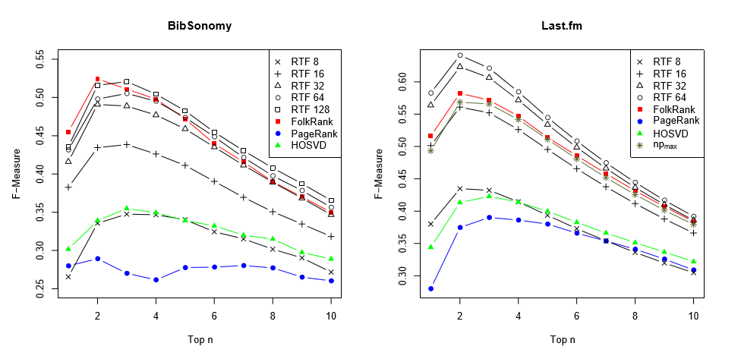
RTF vs. HOSVD

Slide 22
Reference
[1] L. d. Lathauwer, B. d. Moor, and J. Vandewalle. A multilinear singular value decomposition. SIAM Journal of Matrix Analysis and Applications, 21(4):1253–1278, 2000
[2] P. Symeonidis, A. Nanopoulos, and Y. Manolopoulos. Tag recommendations based on tensor dimensionality reduction. In RecSys ’08: Proceedings of the 2008 ACM conference on Recommender systems, pages 43–50, New York, NY, USA, 2008. ACM.
[18] S. Rendle, L. B. Marinho, A. Nanopoulos, and L. Schmidt-Thieme. Learning optimal ranking with tensor factorization for tag recommendation. In KDD ’09: Proceeding of the 15th ACM SIGKDD international conference on Knowledge discovery and data mining, New York, NY, USA, 2009. ACM

